Slide 1

CRIME ANALYSIS IN
THE UNITED STATES
CHICAGO
LOS ANGELES
PRESENTED BY : DATANERDS
NILISHA MAKAM PRASHANTHA
ANISHA RAO
H

Slide 2

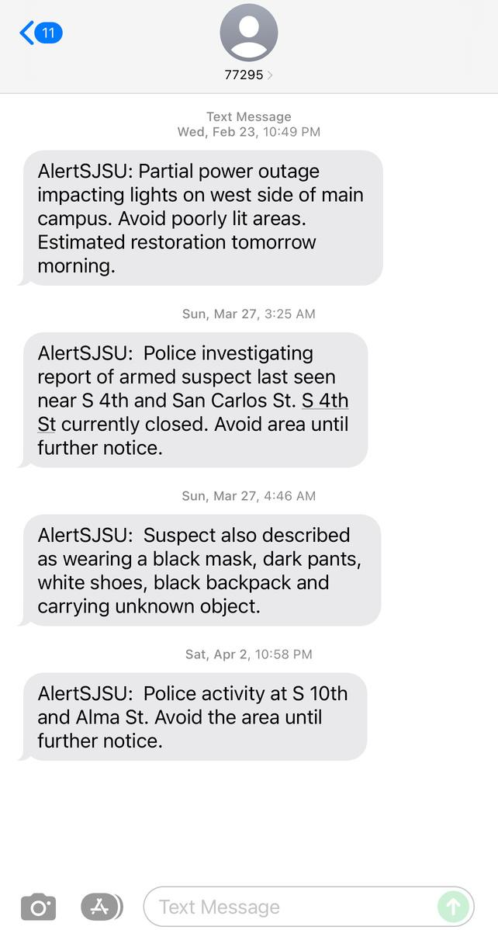

LOOKS FAMILIAR?

Slide 3


CRIME ALERT!!
This is a SJSU crime alert message which we receive every time when a crime incident occurs

Slide 4

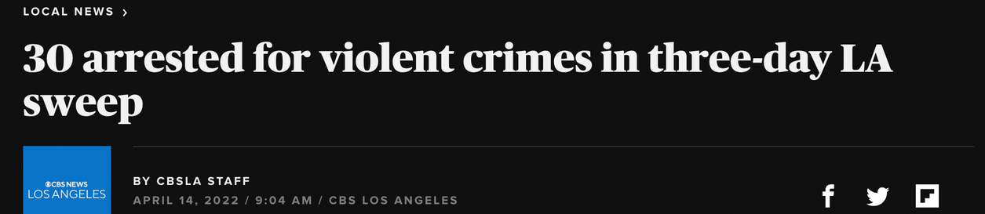

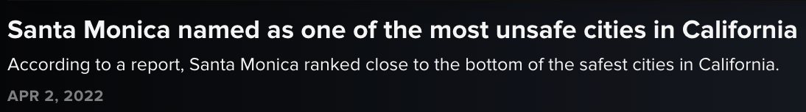

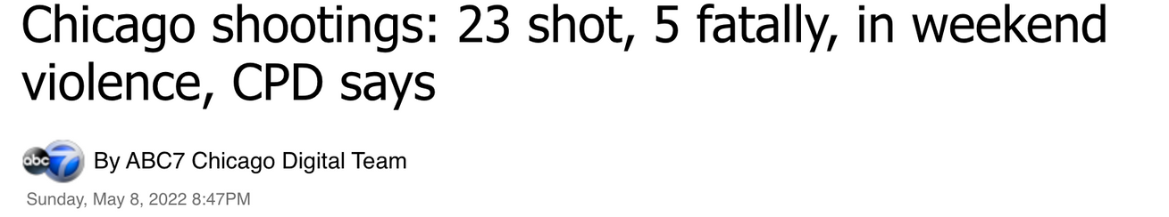
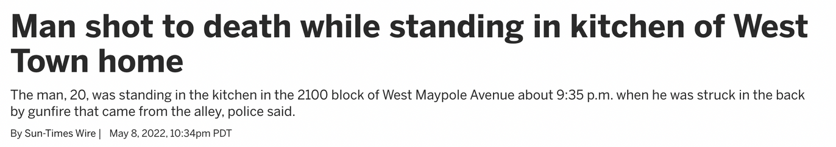
LATEST CRIME NEWS

Slide 5
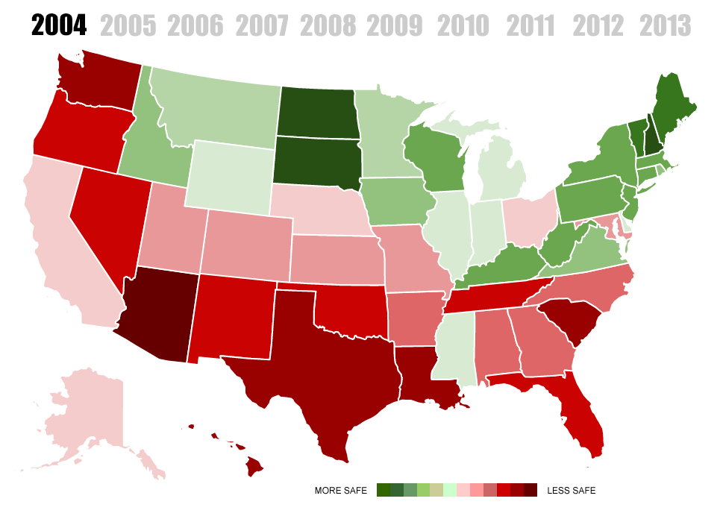

CRIME RATES OVER THE YEARS
THE MOTIVATION
SAFETY
AWARENESS

Slide 6






PROJECT FOCUS
Analyzing the crime data granularities of two highly populated cities in the United States
- Chicago
- Los Angeles
Data collection
from various sources
Visualizations based on the results
Clean and combine data
collected from various sources
Crime data analysis
to find offense characteristics
Data modeled
and stored

Slide 7
DATA FLOW DIAGRAM
START
Defining Queries
Data Sourcing
Data Pre-Processing
AWS Redshift and Analysis
Performing ETL
Data Storage
Data Visualization
Business Impact
Decision Making
END

Slide 8


ABOUT THE DATA
Types of Data
Sourced from
Details of various crimes reported
in LA & Chicago
City-wise official crime data portal
Data description
https://data.cityofchicago.org/Public-Safety/Crimes-2001-to-Present/ijzp-q8t2
https://data.lacity.org/Public-Safety/Crime-Data-from-2020-to-Present/2nrs-mtv8
Details of the offense type,
Location particulars for incidents occurred
Date and time details

Slide 9





COLLABORATIVE TOOLS
AWS SSO
GOOGLE COLAB
CREATE, CONNECT AND SHARE ACROSS AWS SERVICES
CO-CODE TOGETHER,DATA CLEANING, EASY TO ACCESS S3 BUCKET
GITHUB
VERSION CONTROL,
HELPED US MAKE SEPARATE CHANGES TO THE SAME CODE.

Slide 10




DATA PREPROCESSING
#1 Procedure
#2 Procedure
DATA CLEANSING
DATA PROFILING
Detected and corrected corrupt or inaccurate records from the datasets
Used ETL process in data warehousing to format the data accordingly
Examined, analyzed, and created useful summaries of data
DATA TRANSFORMATION

Slide 11





DATA CLEANSING
IMPORTING
DATA
EXPORTING
DATA
MERGING
DATASETS
DATA
REMOVING
MISSING DATA
VERIFICATION
CLEANING
CYCLE
REMOVING DUPLICATES
STANDARDIZATION
NORMALIZATION

Slide 12











CHALLENGES OVERCOME
WHY IS DATA CLEANING
Important?
The scale of the data - 10 Million rows!
Truthfulness & authentication of the project depends on this step
Date-time formatting
Garbage in Garbage Out
WHAT HAPPENS NEXT?

Slide 13













USAGE OF AWS
Data Cleaning
ETL
Data Warehouse
used Google collab
created crime-job as Run on demand basis
loaded data using copy command for analysis
Data Pre-processing
AWS S3
AWS S3
AWS GLUE JOB
AWS S3
REDSHIFT
S3-Input Bucket
S3-Output Bucket
S3-Job Output Bucket
crime-input-bucket
crime-output-bucket
crimes-output-job-bucket

Slide 14


01
WHAT IS S3?
Object storage service that can store huge amount of data
02
CREATED INPUT BUCKET
Input bucket has raw datasets
AWS S3
03
CREATED OUTPUT BUCKET
DATALAKE
Output bucket has pre-processed data
04
CREATED JOB OUTPUT BUCKET
To store all the transformed files from the AWS Glue job

Slide 15






AWS GLUE STUDIO - THE FLOW
Database created in glue catalog
IAM role created - "AWSGlueServiceRole-"
Crawler created and ran to crawl s3 data
Tables created post crawling from s3
Glue jobs utilizing the crawled tables

Slide 16

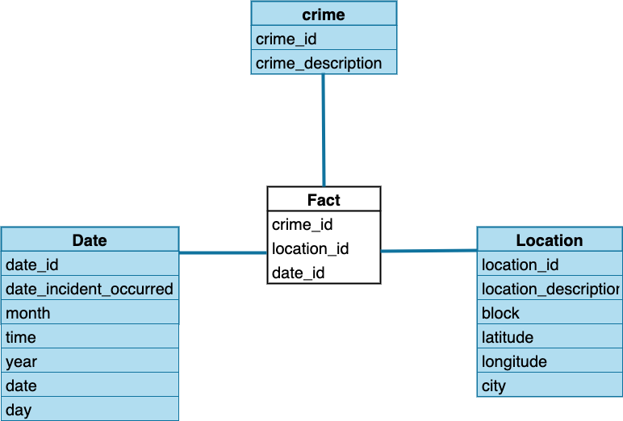

STAR SCHEMA MODELING

Slide 17
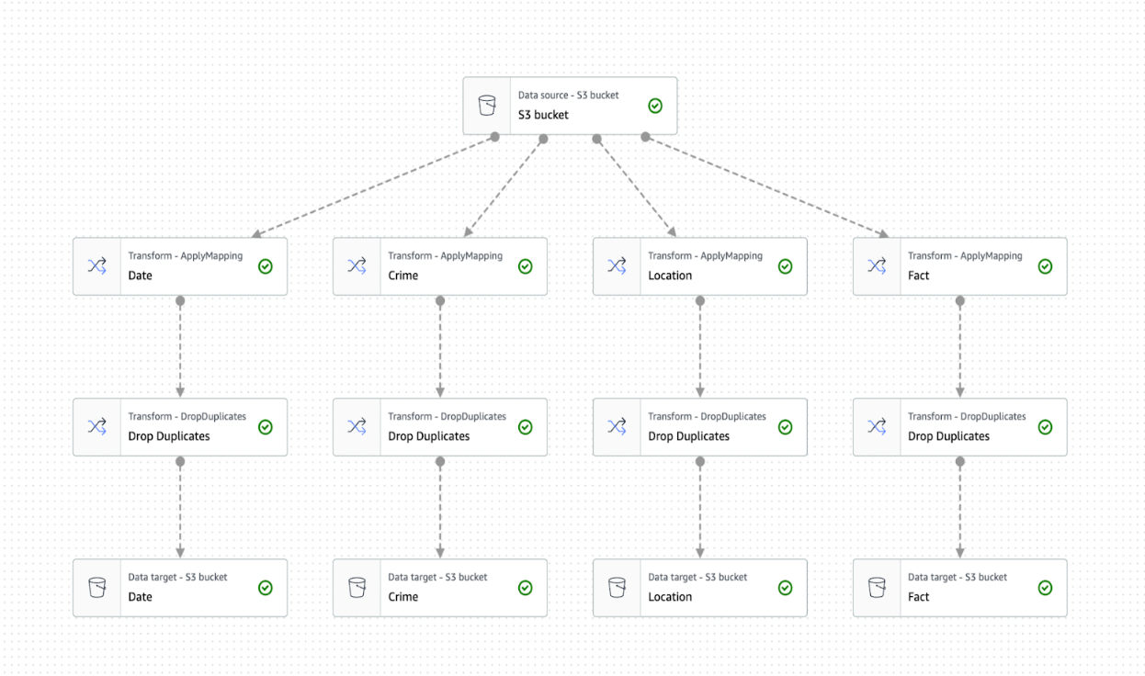


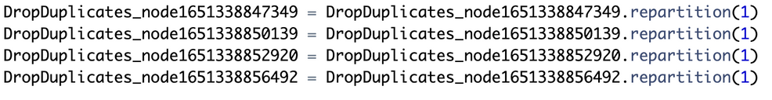
AWS GLUE JOB
Source- Data Glue Catalog
Checked required column boxes
Dropped the duplicate rows
Target-Stored 4 csv files in S3 bucket
To create single file in S3 for each target:

Slide 18






AWS REDSHIFT - THE WAREHOUSE!
Data is Modeled
Visualizations from the results
Database tables created with relationships
Queries performed on the stored data
Data stored along with easy scaling options

Slide 19

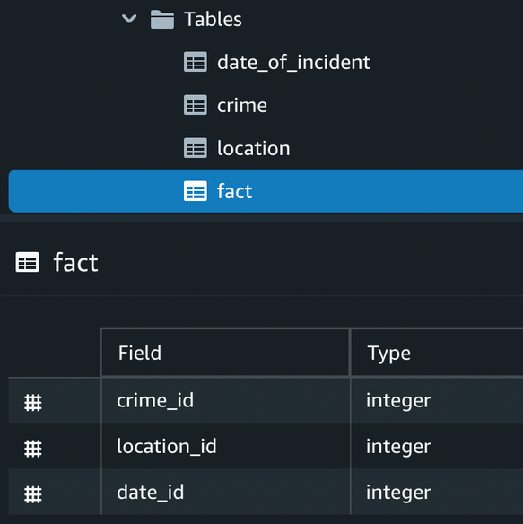
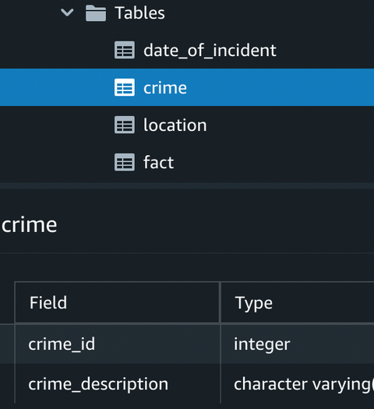
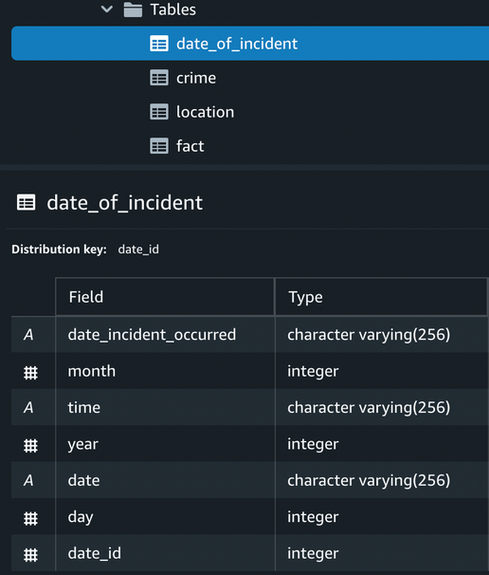
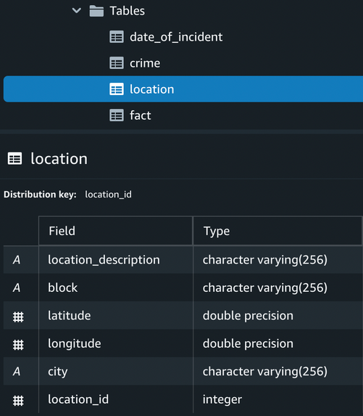
S3 to Redshift
COPY dev.crime.date_of_incident ("date_incident_occurred", month, time, year, date, day, "date_id") FROM 's3://crimes-output-job-bucket/Date' IAM_ROLE 'arn:aws:iam::113131008952:role/redshift-user-role' FORMAT AS CSV DELIMITER ',' QUOTE '"' REGION AS 'us-east-1' IGNOREHEADER 1

Slide 20
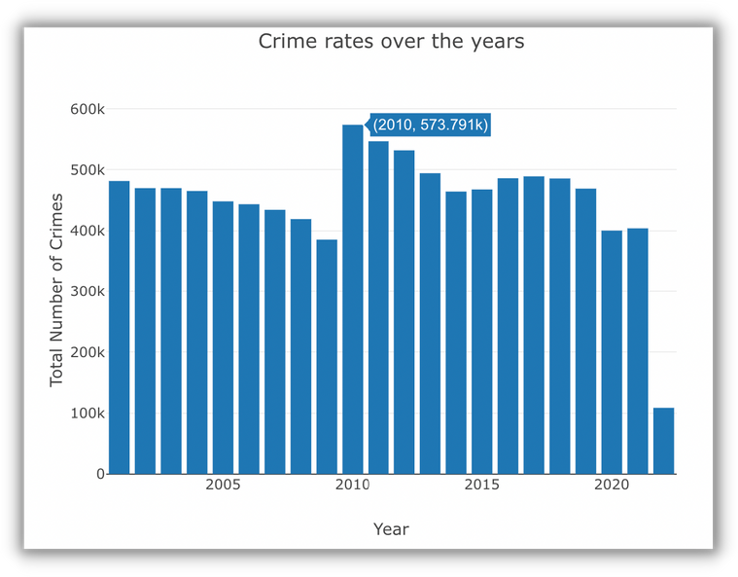
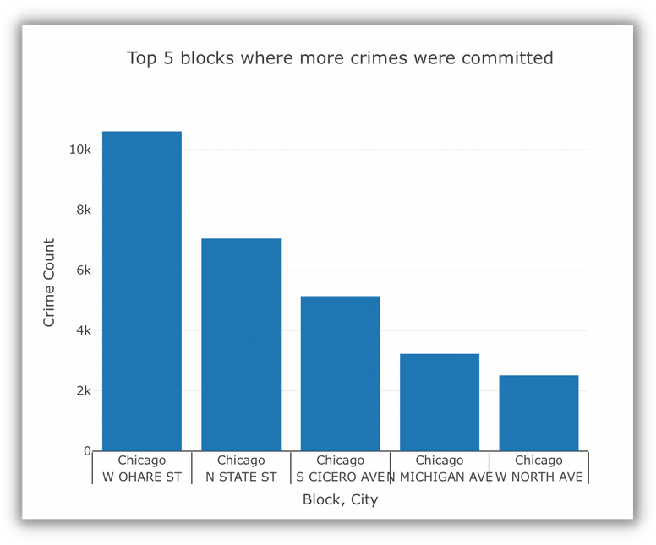
DATA ANALYSIS - AWS Redshift
Displaying Results in Chart Format
Crime rates over the years
SELECT count("crime"."fact"."crime_id") as crime_count, "crime"."date_of_incident".year
FROM "crime"."fact", "crime"."date_of_incident"
WHERE "crime"."fact"."date_id" ="crime"."date_of_incident"."date_id"
group by "crime"."date_of_incident".year;
Top 5 blocks where more crimes were committed
SELECT "crime"."fact"."location_id", "crime"."location"."block", "crime". "location"."location_description","crime". "location"."latitude","crime"."location"."longitude", "crime"."location"."city", count("crime"."fact"."crime_id") as crime_count
FROM "crime"."fact", "crime"."location"
WHERE "crime"."fact"."location_id" ="crime". "location"."location_id"
GROUP BY "crime". "fact". "location_id", "crime". "location". "block", "crime"."location"."city", "crime". "location". "location_description", "crime". "location". "latitude", "crime". "location"."longitude"
ORDER BY crime_count desc limit 5;

Slide 21
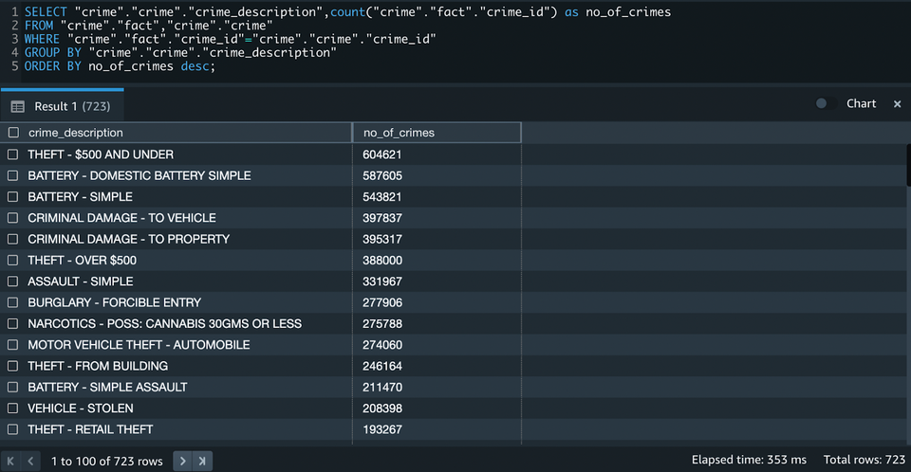
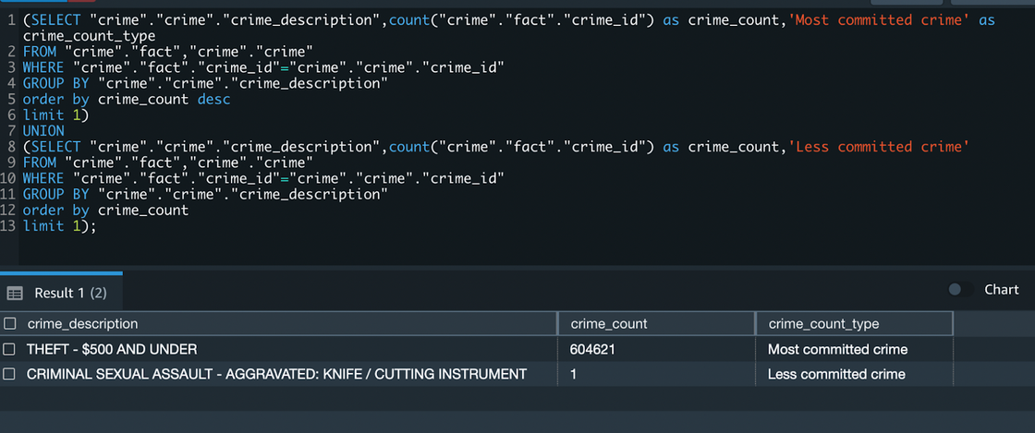
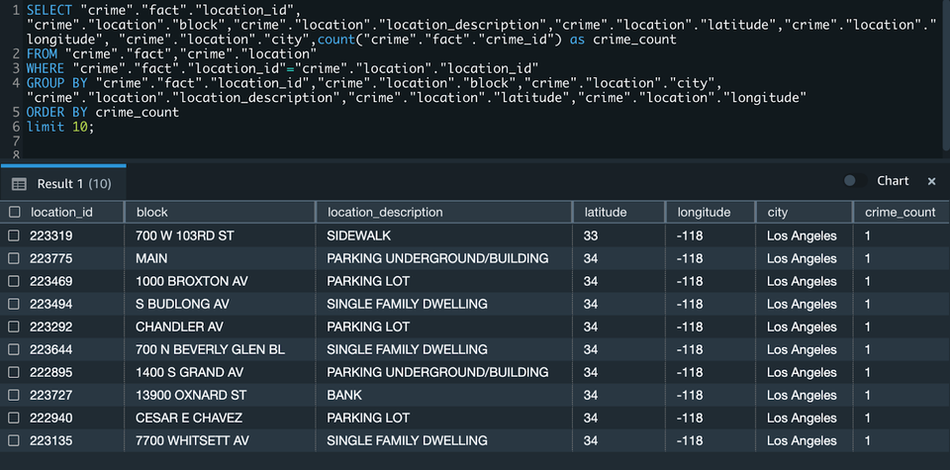
DATA ANALYSIS - AWS Redshift
Displaying Results in Table Format
Total no. of offense type and count of each
Most and Least committed crimes
Least crimes committed location details (least 10)

Slide 22
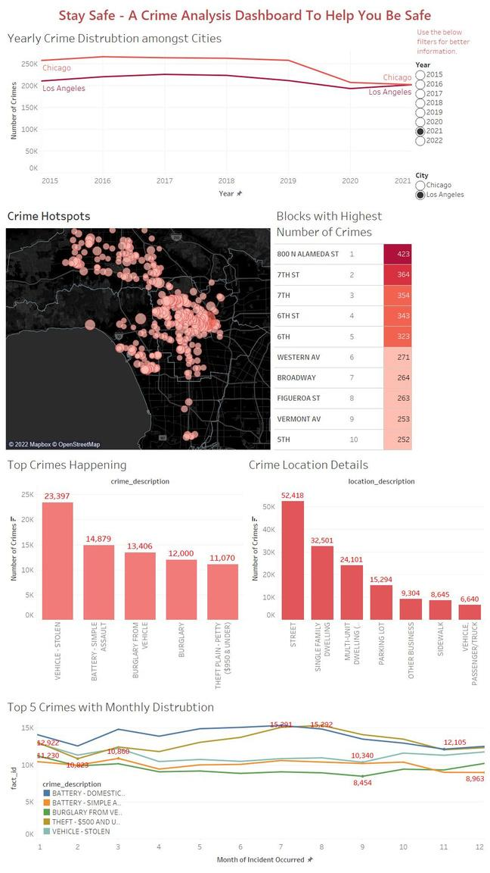
VISUALIZATION - TABLEAU
Custom SQL query for Tableau:
Tableau Dashboard:
SELECT "date_of_incident"."date" as "date","date_of_incident"."date_incident_occurred" as "date_incident_occurred",
"date_of_incident"."day" as "day",
"date_of_incident"."month" as "month",
"date_of_incident"."time" as "time",
"date_of_incident"."year" as"year",
"c"."crime_description" as "crime_description",
"l"."location_description" as "location_description",
"l"."block" as "block",
"l"."latitude" as "latitude",
"l"."longitude" as "longitude",
"l"."city" as "city",
"f"."crime_id" as "fact_id"
FROM "crime"."date_of_incident" "date_of_incident","crime"."crime" as "c", "crime"."fact" as f, "crime"."location" as "l"
WHERE ("f"."crime_id" = "c"."crime_id" and "f"."location_id" = "l"."location_id" and "f"."date_id" = "date_of_incident"."date_id")
and "date_of_incident"."year" >= 2015;
https://public.tableau.com/app/profile/dhruv.jain/viz/USCrimes_16521197188750/Dashboard1

Slide 23

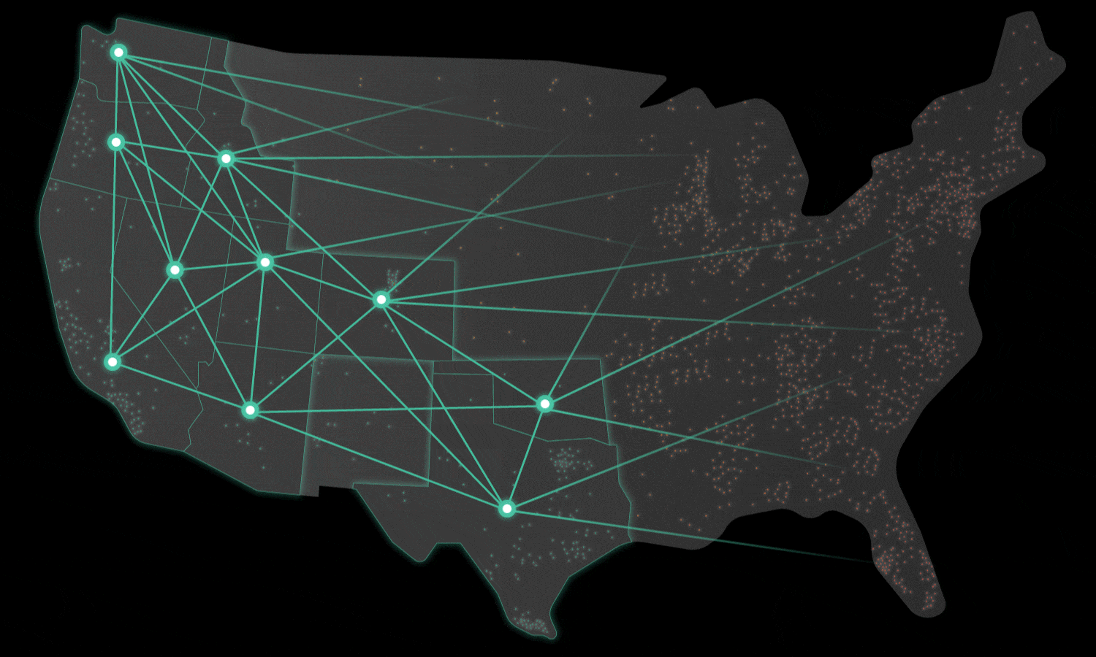


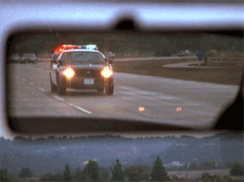

BUSINESS IMPACT
Supports police operations by finding the crime hotspots along with the most committed crimes
Beneficial information helps in decision making for locals, students, and hodophile to plan a safer visit to other locations
Modeling police patrol activities timings by predicting which period of the day most crimes are committed
Ensuring the physical and mental security of the people in the society
Maintaining records of crime rates over the years

Slide 24







1
Real time data collection from social media applications
2
We plan to expand and include other locations in our analysis
3
A platform for the users with or without domain knowledge
4
Correlate weather and real estate data to check its impact on crime
SCHOOL
ADMISSION FUNNEL
5
Building visual investigation technique for police authorities
FUTURE ENHANCEMENTS?

Slide 25
RESOURCES
https://www.youtube.com/c/AndyKriebel
https://public.tableau.com/en-gb/s/resources
https://abdulrwahab.medium.com/amazon-redshift-overview-3175ddb56eca
https://docs.aws.amazon.com/redshift/latest/mgmt/query-editor-v2-charts.html
AWS REDSHIFT
Tableau
https://towardsdatascience.com/the-ultimate-guide-to-data-cleaning-3969843991d4
https://us-east-console.aws.amazon.com/gluestudio/home?region=us-east-1#/
https://github.com/doitintl/aws-glue-workshop/blob/master/FAQ_and_How_to.md
AWS GLUE
Data
Cleaning

Slide 26





OUR TEAM
Anisha Rao
Dhruv Jain
Nilisha MP
Varsha Srinivasan
anisha.rao@sjsu.edu
dhruv.jain@sjsu.edu
nilisha.makamprashantha@sjsu.edu
varsha.srinivasan@sjsu.edu
Special Thanks to Professor, Andrew Bond

Slide 27


Thank
you!
QUESTIONS?

